Slide 1
Transformers

Slide 2
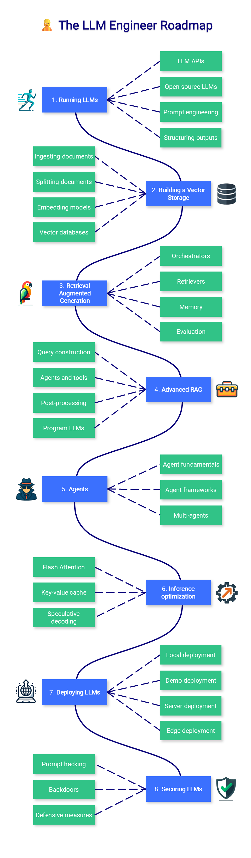
AI Engineer

Slide 3
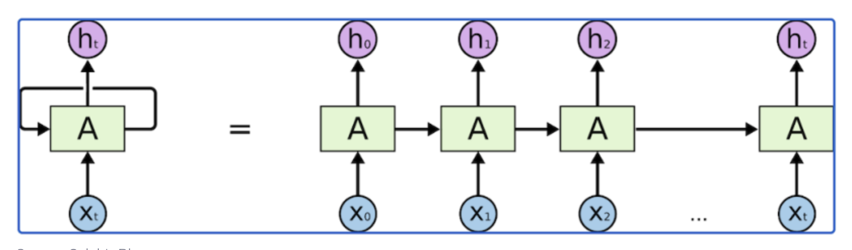
RNN & Limitations
RNNs are feed-forward neural networks that are rolled out over time
Unlike normal neural networks, RNNs are designed to take a series of inputs with no predetermined limit on size.
Memory is short : The following will be challenging
I grew up in Germany with my parents,
I spent many years there and have proper knowledge about their culture. That’s why I speak fluent ____.

Slide 4
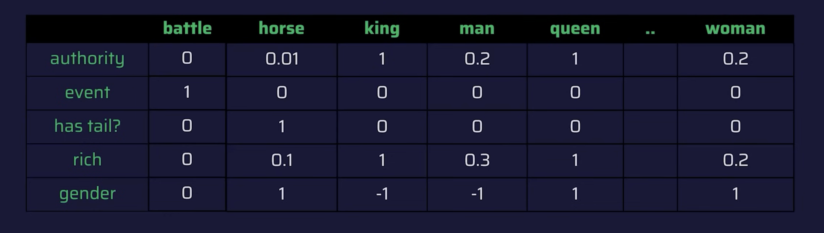
Embedding
Each word will be represented into a vector which is basically answer to questions

Slide 5
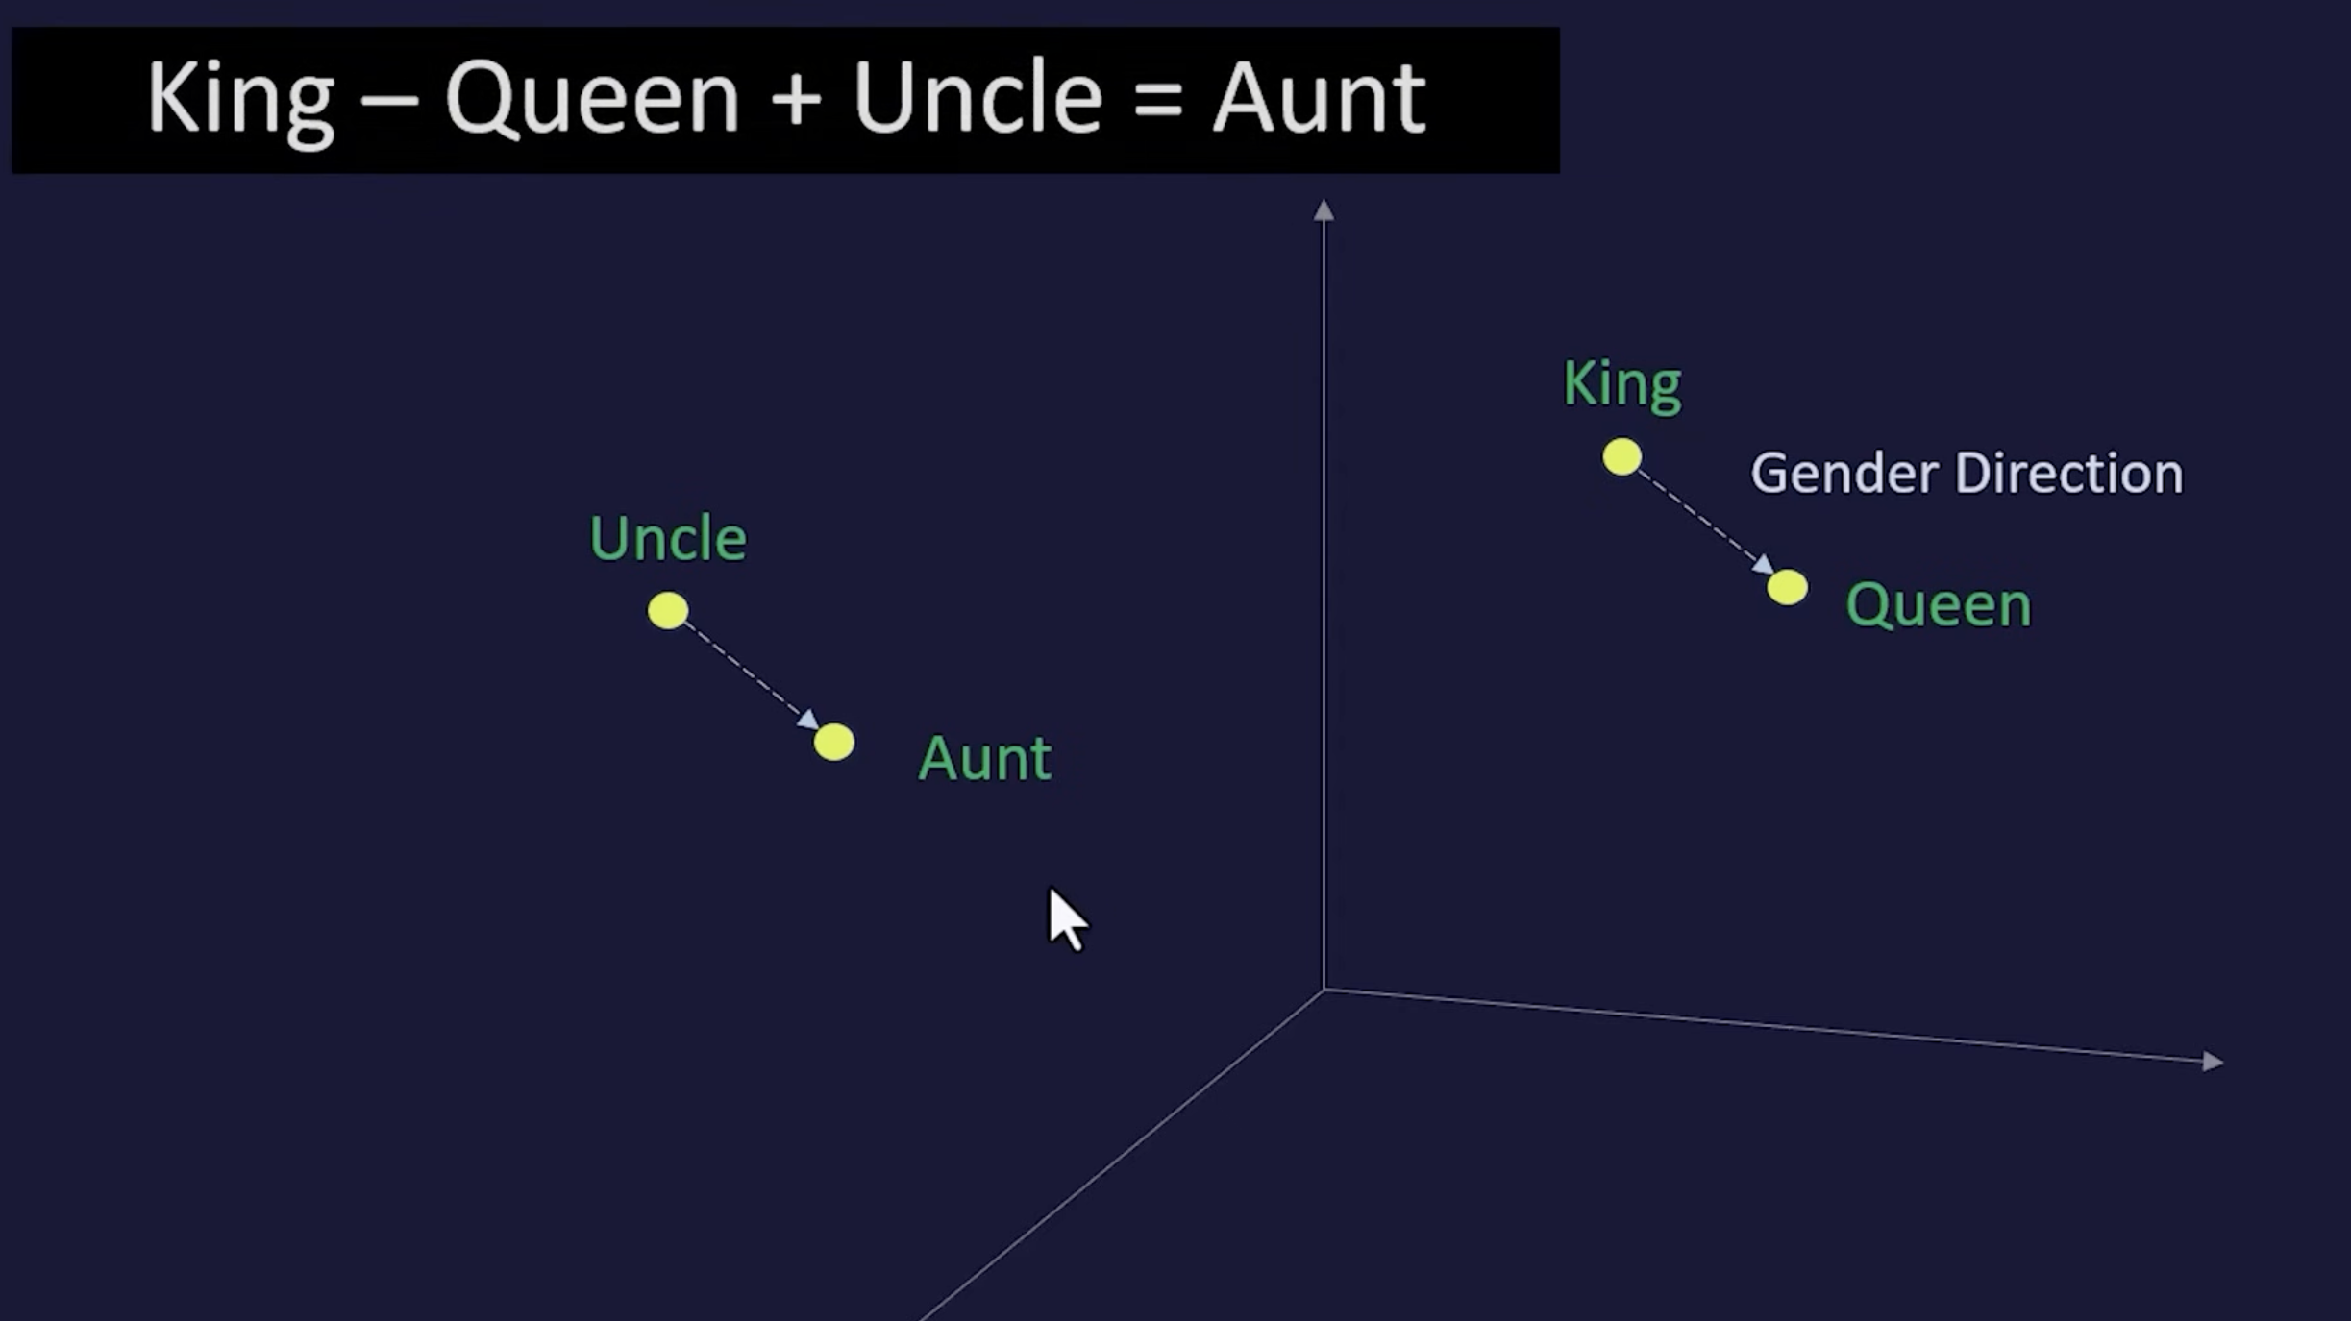

Slide 6
Static Embedding
Glove
Word 2 Vec

Slide 7
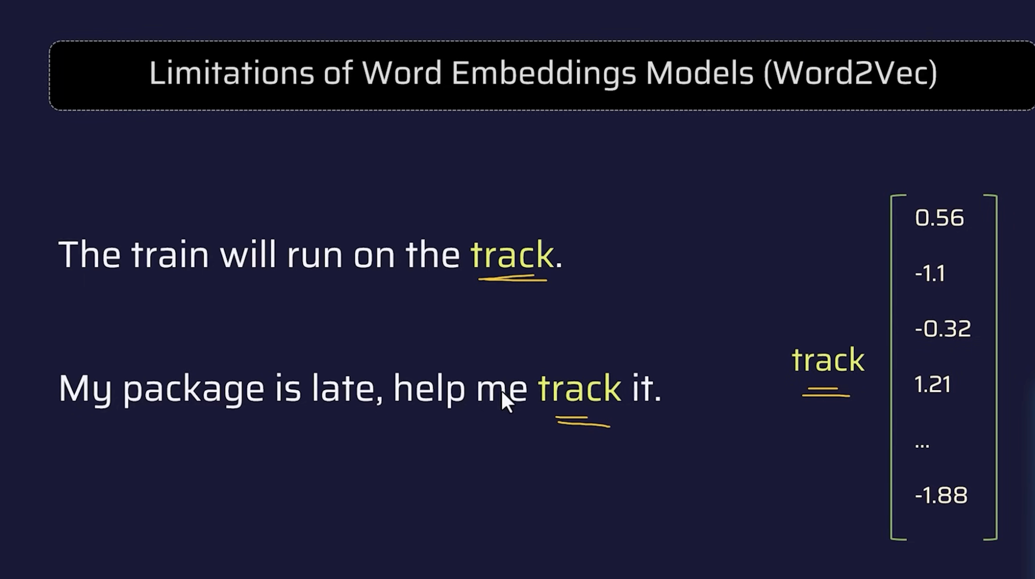

Slide 8
Contextual Embeddings
Contextual embedding models process the entire sequence of words in a sentence.
They create a vector representation for each word that reflects its specific role and meaning within that particular sentence.
This allows them to capture the nuanced meaning, which is crucial for understanding idiomatic expressions, homonyms, and complex sentences.

Slide 9
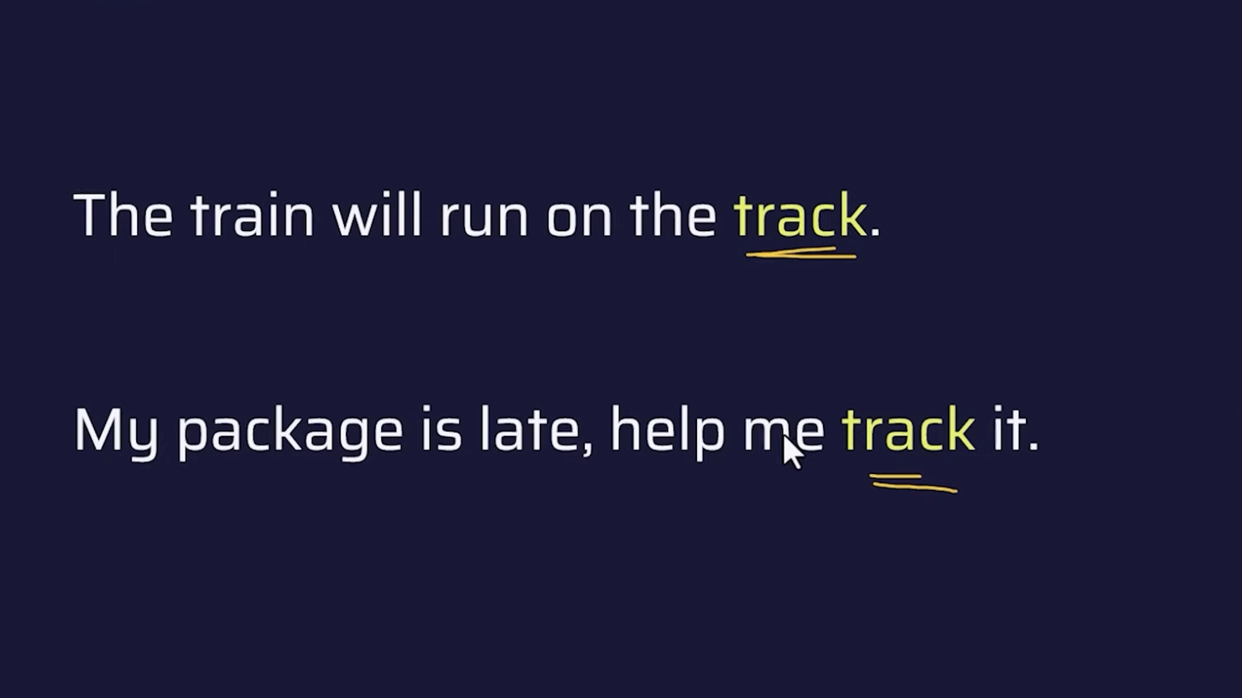
Embedding of Track + Train give Contextual Embedding

Slide 10
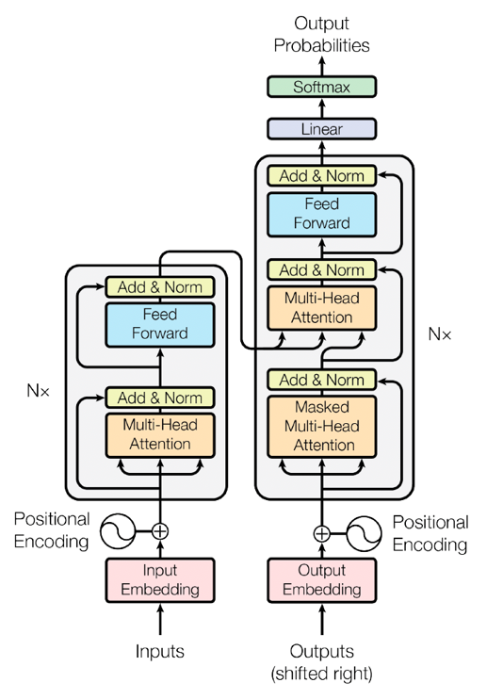
Transformers
Encoder
Generate Contextual
Embeddings
Decoder
Predict Next Word

Slide 11
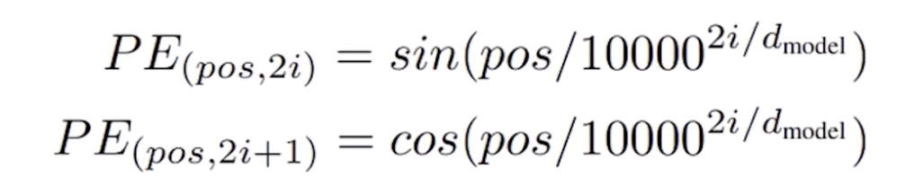
With an Example
I want to go to Europe and see Eiffel tower . I will be booking tickets to ………..
[CLS] I want to go to Europe and see Eiffel tower [SEP] I will be book ing tickets to
text
GPT
50k Tokens
tokens
101
1
42
……………………………………..
201
……………………………..
tokenID
1.09
5.09
0.45
0.0
0.09
-0.09
0.09
0.0
3.09
7.09
-3.09
0.2
Static Embedding
2.09
2.09
2.05
0.4
1.07
1.04
2.3
2.3
0.1
0.0
Positional Encoding
0.1
0.0
0.4
0.2
0.2
0.2
1.19
1.19
1.19
Embedding with Position
0.29
1.19
3.09
3.09
3.09
3.09
2.09
2.09
2.09
2.09

Slide 12
Attention is All you need
Attention in neural networks is somewhat similar to what we find in humans. It means they focus on certain parts of the inputs while the rest gets less emphasis.
I want to go to Europe and see Eiffel tower . I will be booking tickets to ………..
Europe might attend to word tickets by 0.4
Eiffel might attend to word ticket by 0.5
I , want , to , go might attend to tickets by 0.01

Slide 13
It is actually a Matrix
 | I | want | go | Book | to | See | Eiffel | Tower | Book | Tickets
I
Want
go
to
Eiffell
Tower
Book
Tickets | 0.01 | 0.02 | 0.2 | 0.3 | 0.02 | 0.1 | 0.7 | 0.7 | 0.5

Slide 14
Query --- Key --- Value
Query - Your Search Request – E.g. Find me where embeddings are generated in AIDP
Key – Clues – Information to retrieve – E.g. Code base with folder Embeddings
Value – Answer – Embedding generation code

Slide 15
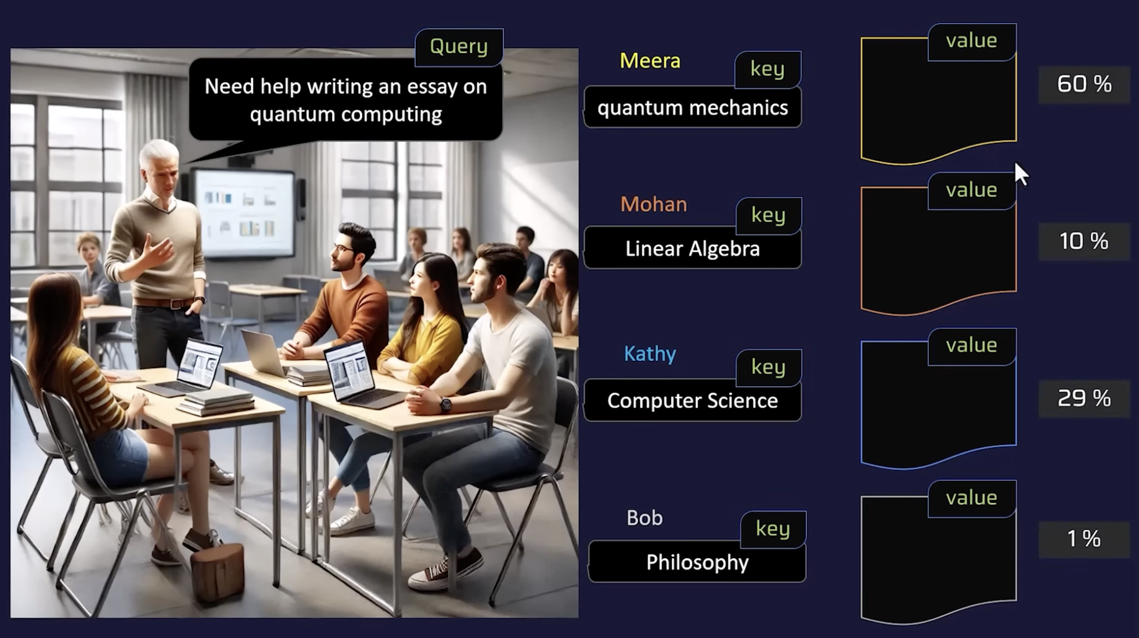

Slide 16
I -- Key – I am adjective to say who is it
Want -- Key – I am Verb
To
Go
To
Europe- Key – I am adjective to say where
To
See
Eiffel- Key – I am adjective to say where
Tower
Book
Tickets --- Query – I want to know modifiers .(Adjectives )
to
attention = Softmax( (Q * K) / Scale) Context aware embedding for attention layer = attention * V

Slide 17
Query Vector
I want to go to Europe and see Eiffel tower . I will be booking tickets to
Wq
E8-Embedding of Ticket
Q7
0.2 0.3 0.4
0.32 0.32 0.43
0.5 | 0.3 | 0.2 |  | 0.1
-0.2 | -.1 | -1 |  | 0.9
0.4 | 0.5 | 0.2 |  | 0.7
128
12288
12288
Wq llearnt during training Knows how to find/encode the query of attention

Slide 18
Key Vector
I want to go to Europe and see Eiffel tower . I will be booking tickets to
Wk
E8-Embedding of Eiffel
k7
0.2 0.3 0.4
0.12 0.32 0.43
0.5 | 0.3 | 0.2 |  | 0.1
-0.2 | -.1 | -1 |  | 0.9
0.4 | 0.5 | 0.2 |  | 0.7
128
12288
12288
Wk llearnt during training Knows how to find/encode the Key of attention

Slide 19
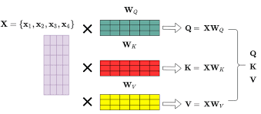
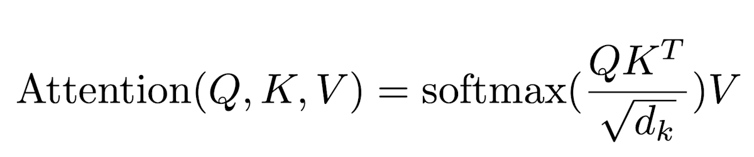
In short

Slide 20
Multi Head Attention
Wq1,Wk1,Wv1
Attention
Head1
I
Want
To
Visit
Eiffel
Tower
Book
Tickets
to
Attention
Head1
Con Aware E1
Positional
Embeddings
Feed Forward
Attention
Head1
Con Aware En
Wqn,Wkn,Wvn
Attention
Headn

Slide 21
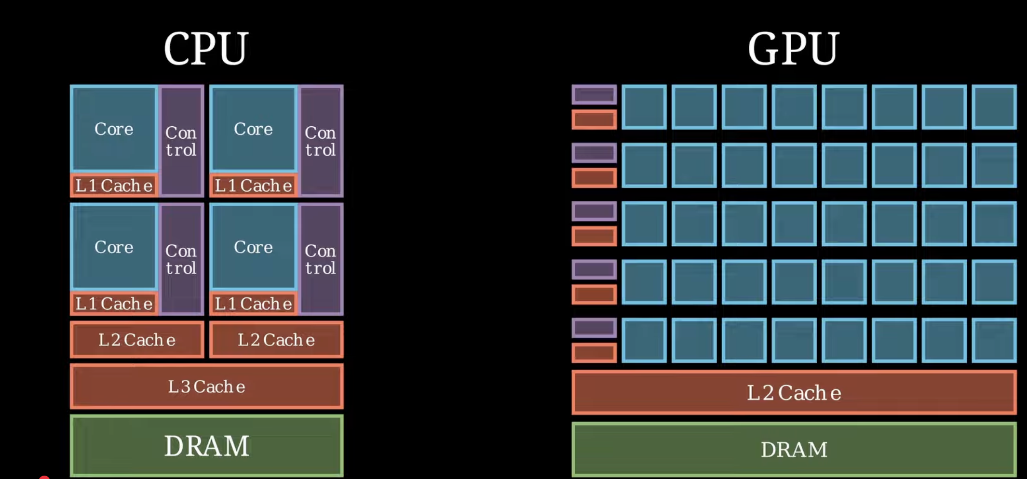
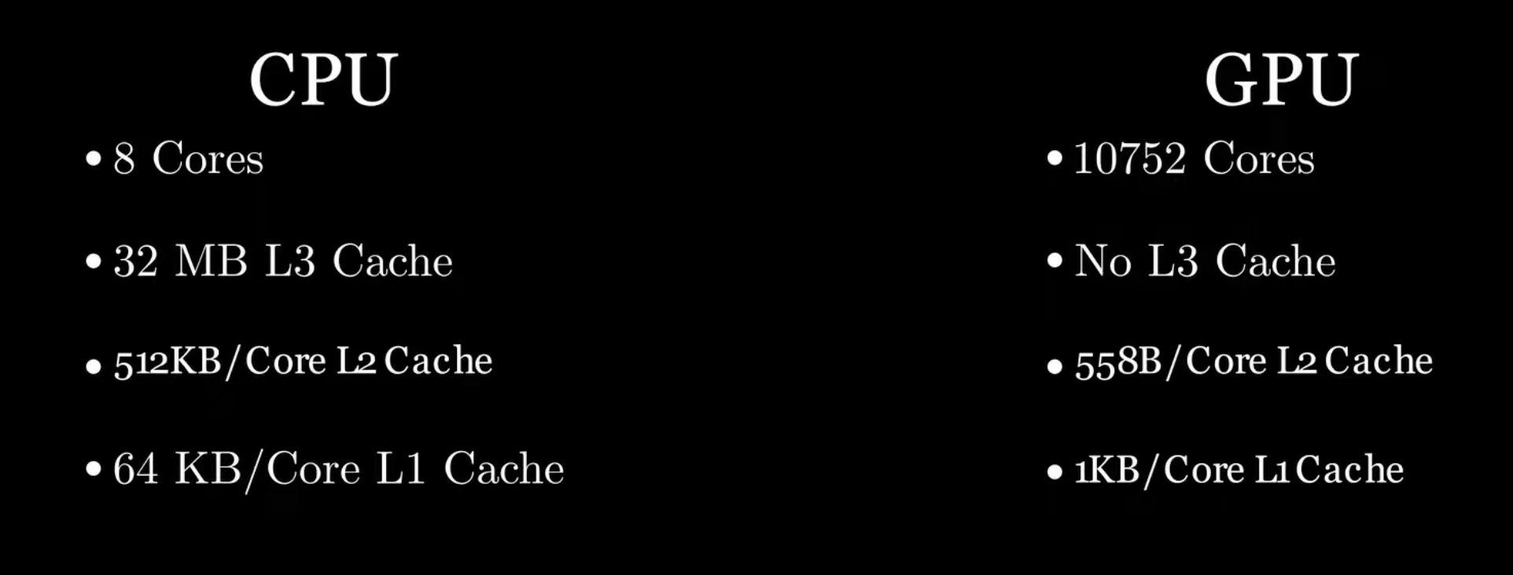
GPU Primer

Slide 22
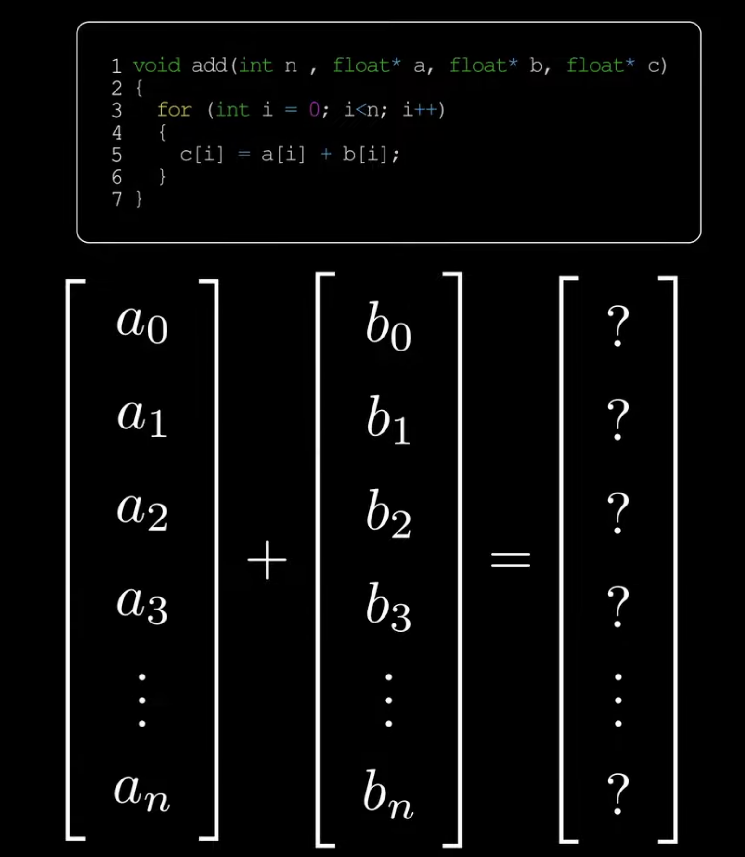
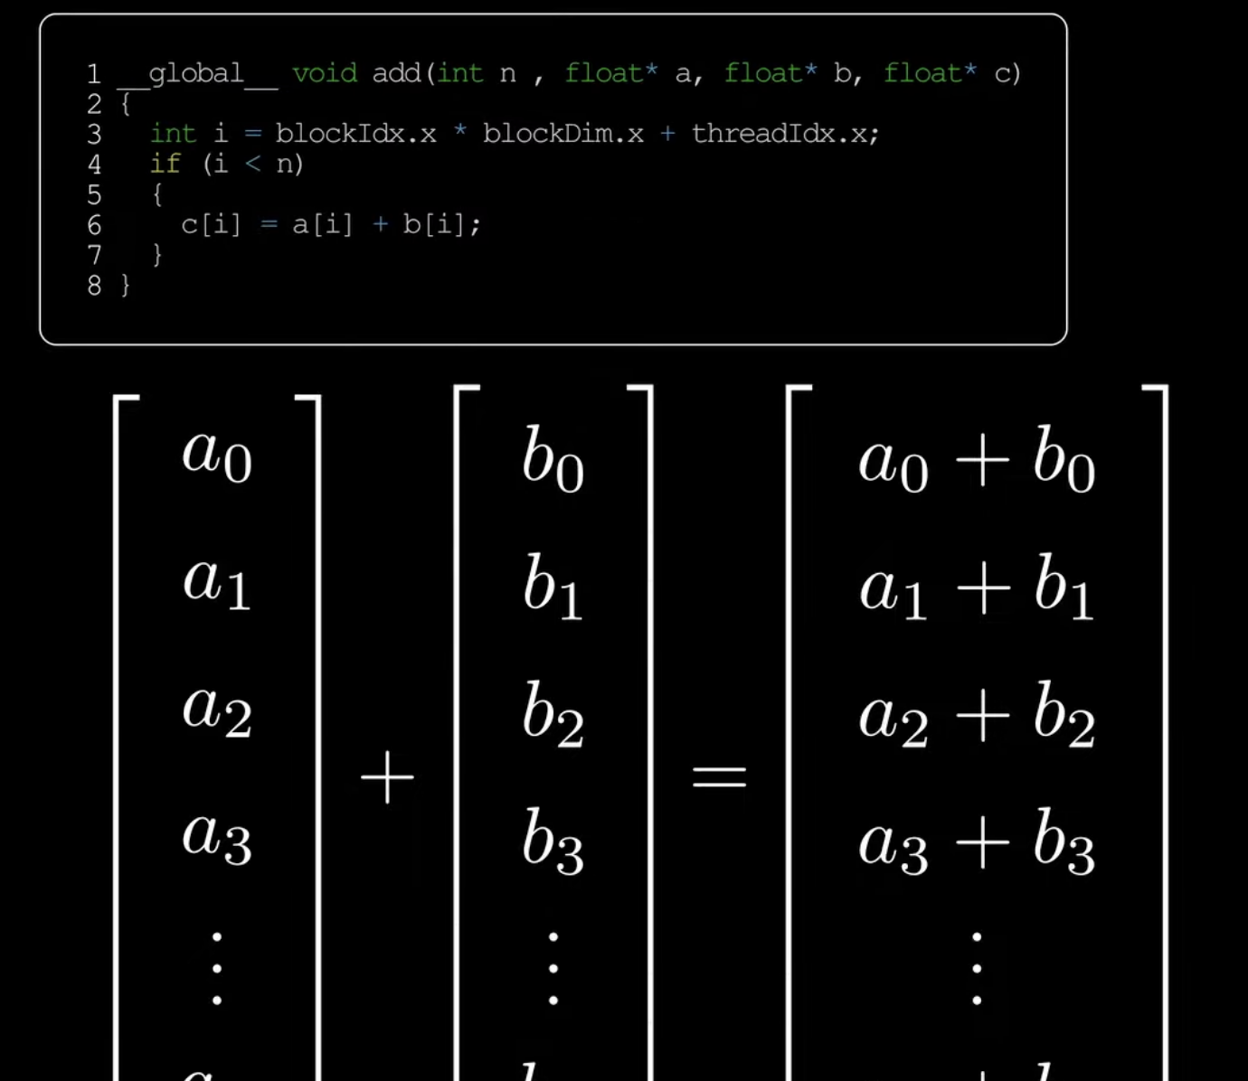
AI – Embarrassingly Parallel

Slide 23
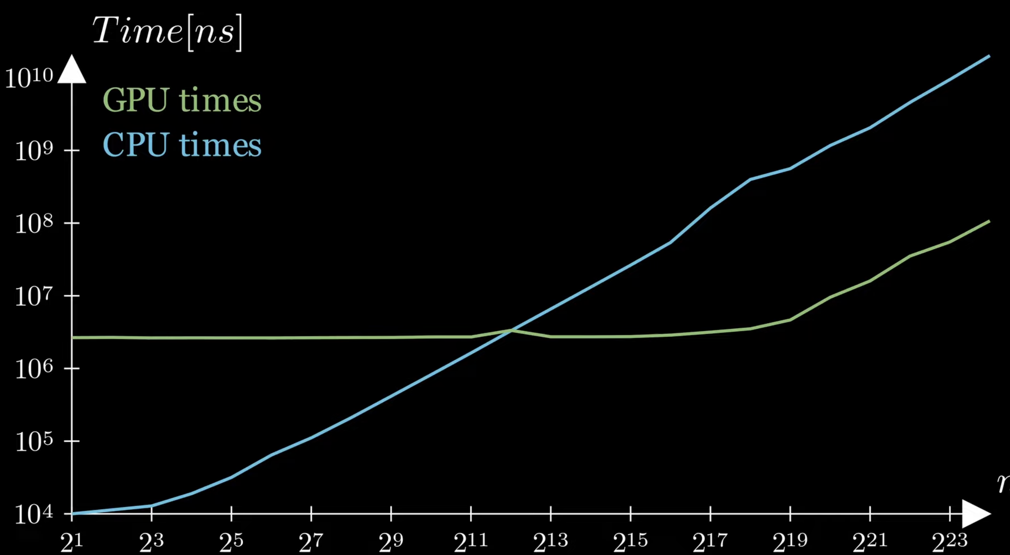

Slide 24
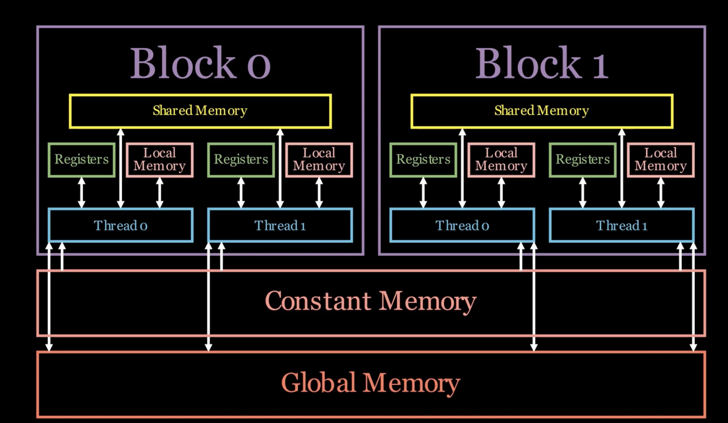
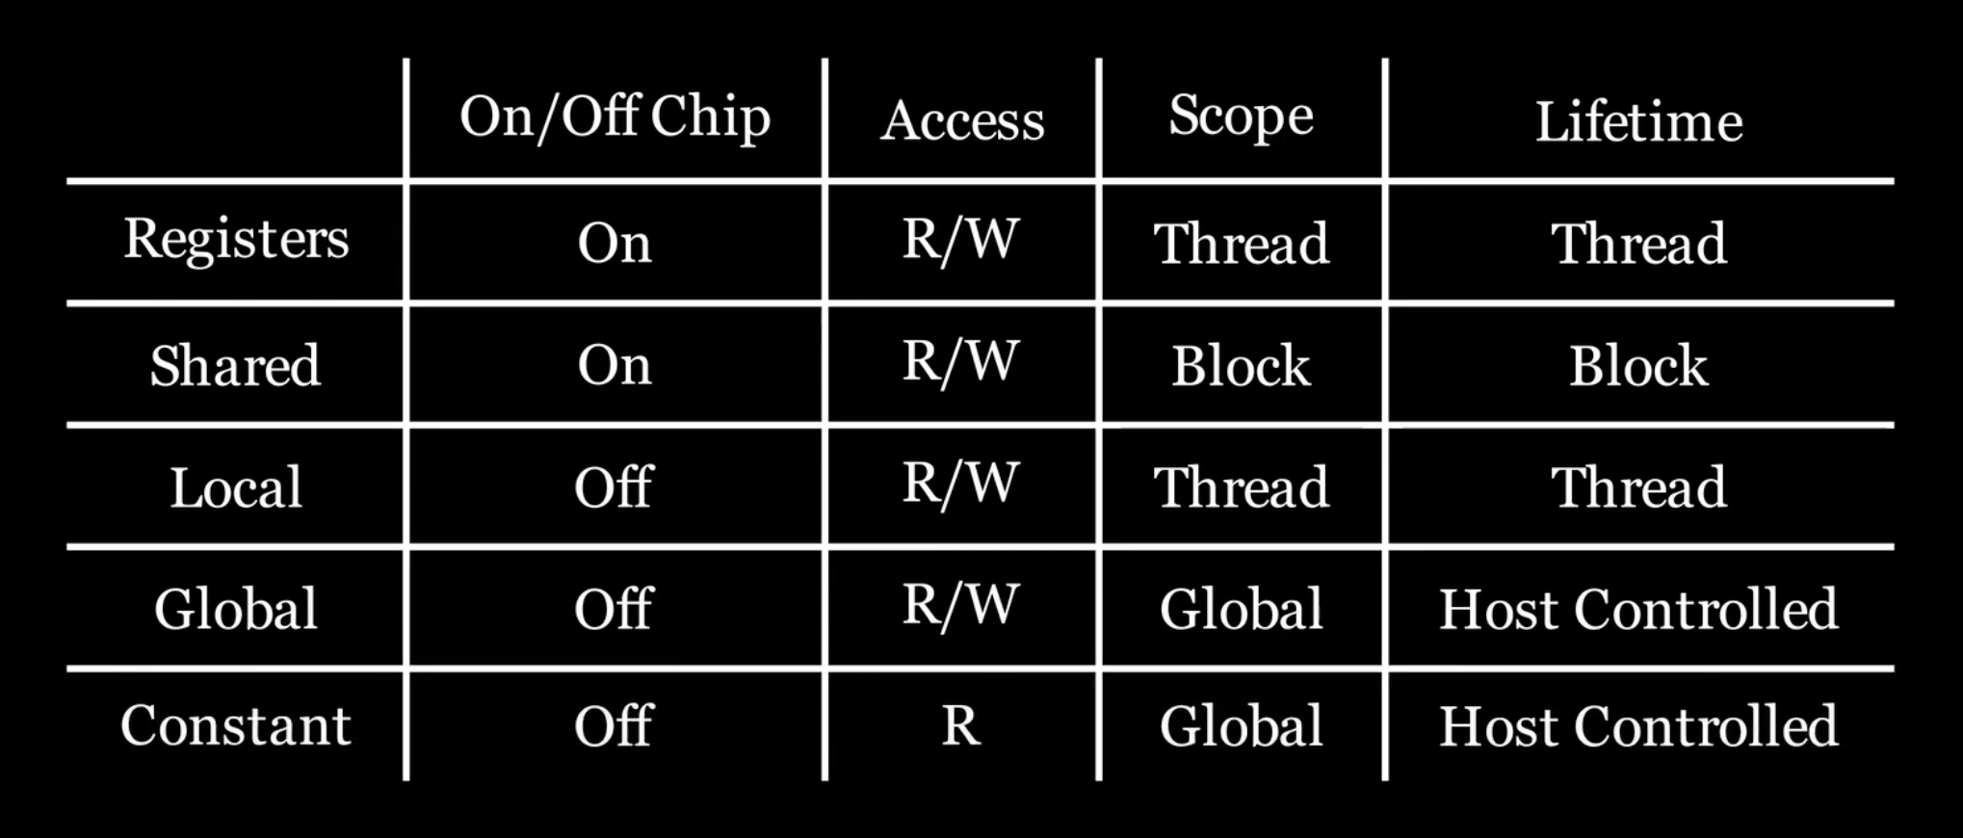
Memory Heirarchy

Slide 25
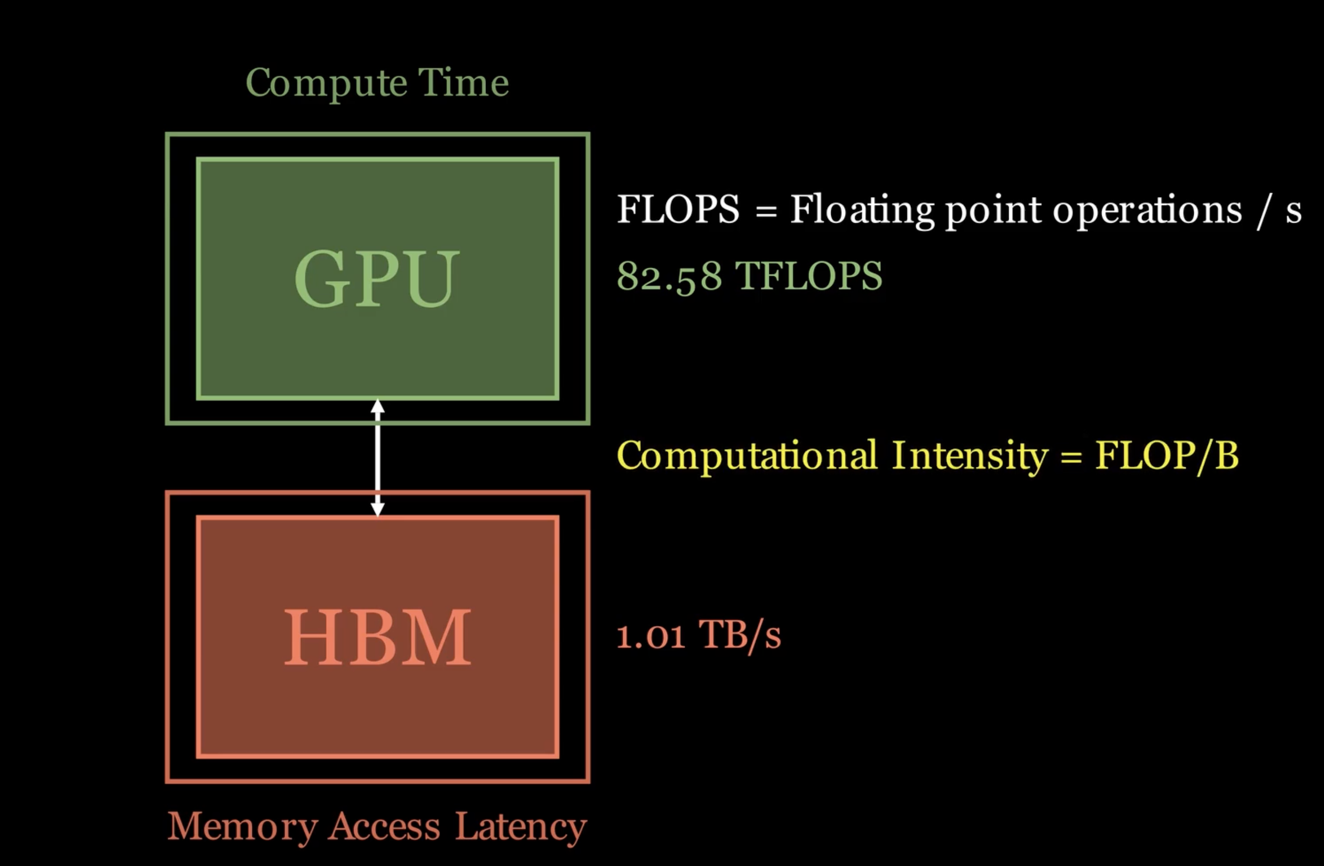
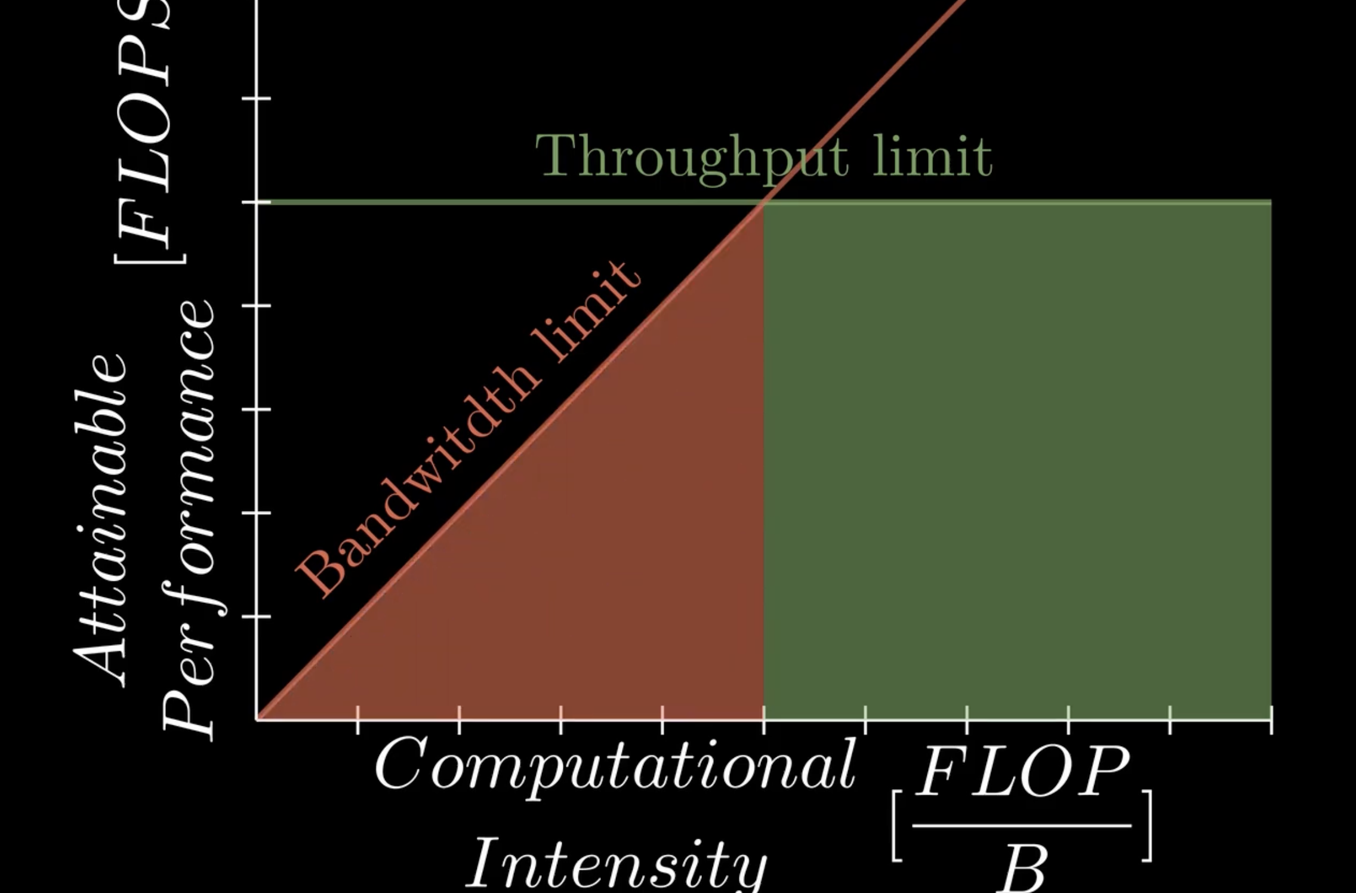
Selecting GPU for LLM

Slide 26
Reading GPU data sheet
FP32 | 31.2 TF
TF32 Tensor Core | 62.5 TF | 125 TF*
BFLOAT16 Tensor Core | 125 TF | 250 TF*
FP16 Tensor Core | 125 TF | 250 TF*
INT8 Tensor Core | 250 TOPS | 500 TOPS*
INT4 Tensor Core | 500 TOPS | 1000 TOPS*
GPU Memory | 24 GB GDDR6
GPU Memory Bandwidth | 600 GB/s
Max TDP Power | 150W
LLM Memory Needed :
Weights :7B parameter model, for instance, will take up approximately 14 GB of memory

Slide 27
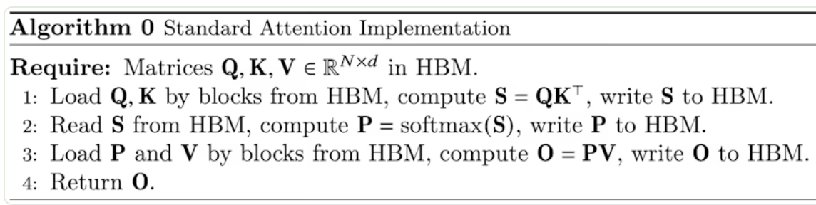
Arithmetic Intensity of A10
ops_to_byte_A10 = compute_bw / memory_bw
= 125 TF / 600 GB/S
= 208.3 ops / byte
Arithmetic Intensity of LLM
N is the sequence length of the LLM, which sets the context window.
For Llama 2 7B, N = 4096.
d is the dimension of a single attention head.
For Llama 2 7B, d = 128.
Q, K, and V are all matrices used to compute attention.
Their dimensions are N by d, or in our case 4096x128.
S and P are both matrices calculated during the equation.
Their dimensions are N by N, or in our case 4096x4096.
O is the output matrix with the results of the attention calculation.
O is an N by d matrix, or in our case 4096x128

Slide 28
 | Load from Mem | Compute | Store to Memory
Line 1: | size_fp16 * (size_Q + size_K) | cost_dot_product_QK * size_S | size_fp16 * size_S
 | = 2 * 2 * (N * d) | = (2 * d) * (N * N) | = 2 * (N * N)
Line 2: | size_fp16 * size_S | cost_softmax * size_P | size_fp16 * size_P
 | = 2 * (N * N) | = 3 * (N * N) | = 2 * (N * N)
Line 3: | size_fp16 * (size_P + size_V) | cost_dot_product_PV * size_O | size_fp16 * size_O
 | = 2 * ((N*N) + (N * d)) | = (2 * N) * (N * d) | = 2 * (N * d)
total_memory_movement_in_bytes:
= (2 * 2 * (N * d)) + (2 * (N * N)) +
(2 * ((N*N) + (N * d))) + (2 * (N * N))
+ (2 * (N * N)) + (2 * (N * d))
= 8N^2 + 8Nd bytes
total_compute_in_floating_point_ops:
= ((2 * d) * (N * N)) +
(3 * (N * N)) + ((2 * N) * (N * d))
= 4(N^2)d + 3N^2 ops
arithmetic_intensity_llama
~= total compute / total memory movement
= 4d(N^2) + 3N^2 ops / 8N^2 + 8Nd bytes
= 62 ops/byte for Llama 2 7B

Slide 29
Memory Bound
Can we use remaining 10 GB for Batching KV Cache ??
kv_cache_size per token of llama
= (2 * 2 * n_layers * d_model) bytes/token = (4 * 32 * 4096) bytes/token = 524288 bytes/token ~ 0.00052 GB/token
kv_cache_tokens A10 can accommodate :
= 10 GB / 0.00052 GB/token
= 19,230 tokens
Llama max context limit : 4096 tokens
We can achieve 4 batches
In summary, to make the most of the compute capacity that we’re paying for, we want to batch 4 requests at a time during inference to fill our KV cache. This will increase our throughput.

Slide 30
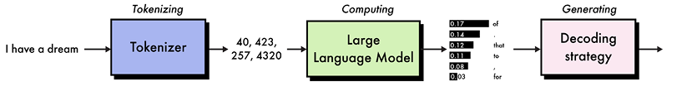
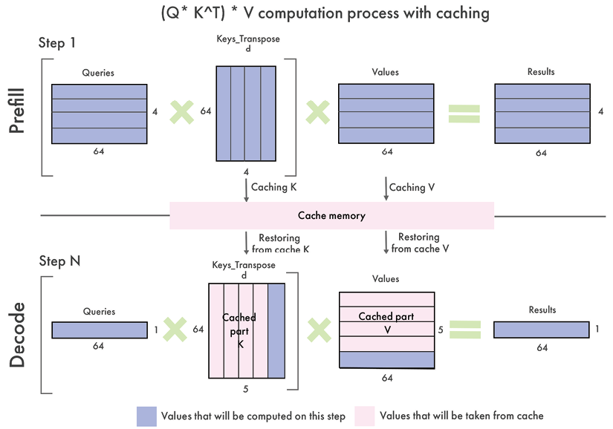
LLM Inference Optimization
KV Cache

Slide 31
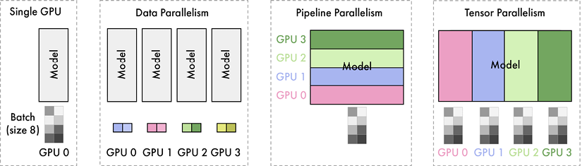
Speculative Decoding
Attention – Paged and Flash Attention
Multiple GPUs
Tensorrt- LLM in Triton

Slide 32
Technique | TGI | vLLM | TensorRT-LLM
Continuous batching | ✓ | ✓ | ✓
Speculative decoding | ✓
FlashAttention2 | ✓ | ✓ | ✓
PagedAttention | ✓ | ✓ | ✓
Pipeline parallelism |  |  | ✓
Tensor parallelism | ✓ | ✓ | ✓
GPTQ | ✓ |  | ✓
EXL2 | ✓
AWQ | ✓ | ✓ | ✓
Summary of features for TGI, vLLM, and TensorRT-LLM

